Slide 1
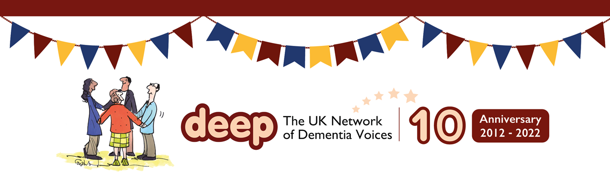
A warm DEEP welcome to Manchester

Slide 2
What we have in store for you today …
Welcome and housekeeping
Why we are here? – to celebrate 10 years of DEEP
Introductions: Who are you and where have you come from

Slide 3
What we have in store for you today …
A rough plan of the day
11.15 – Educate
11.40 – Fabulous Forgetful Friends
12ish – Capturing your words an creating a song

Slide 4
What we have in store for you today …
12.30 – 1.30 – Lunch!
1.30 THRED
1.45 – Forget Me Nots Carlisle
2.00 – Hearing from other groups
2.30 Tea, Coffee and CAKE

Slide 5
What we have in store for you today …
Between 2.30 and 3.15 we will also have the opportunity to continue creating our DEEP song
3.15 Performance of the DEEP song and closing words
3.30 Home!

Slide 6
What we have in store for you today …
At various points in the day the wonderful Jo from Fabulous Forgetful Friends will also be getting us to stretch our various artificial or gout riddled limbs and brain cells.

Slide 7
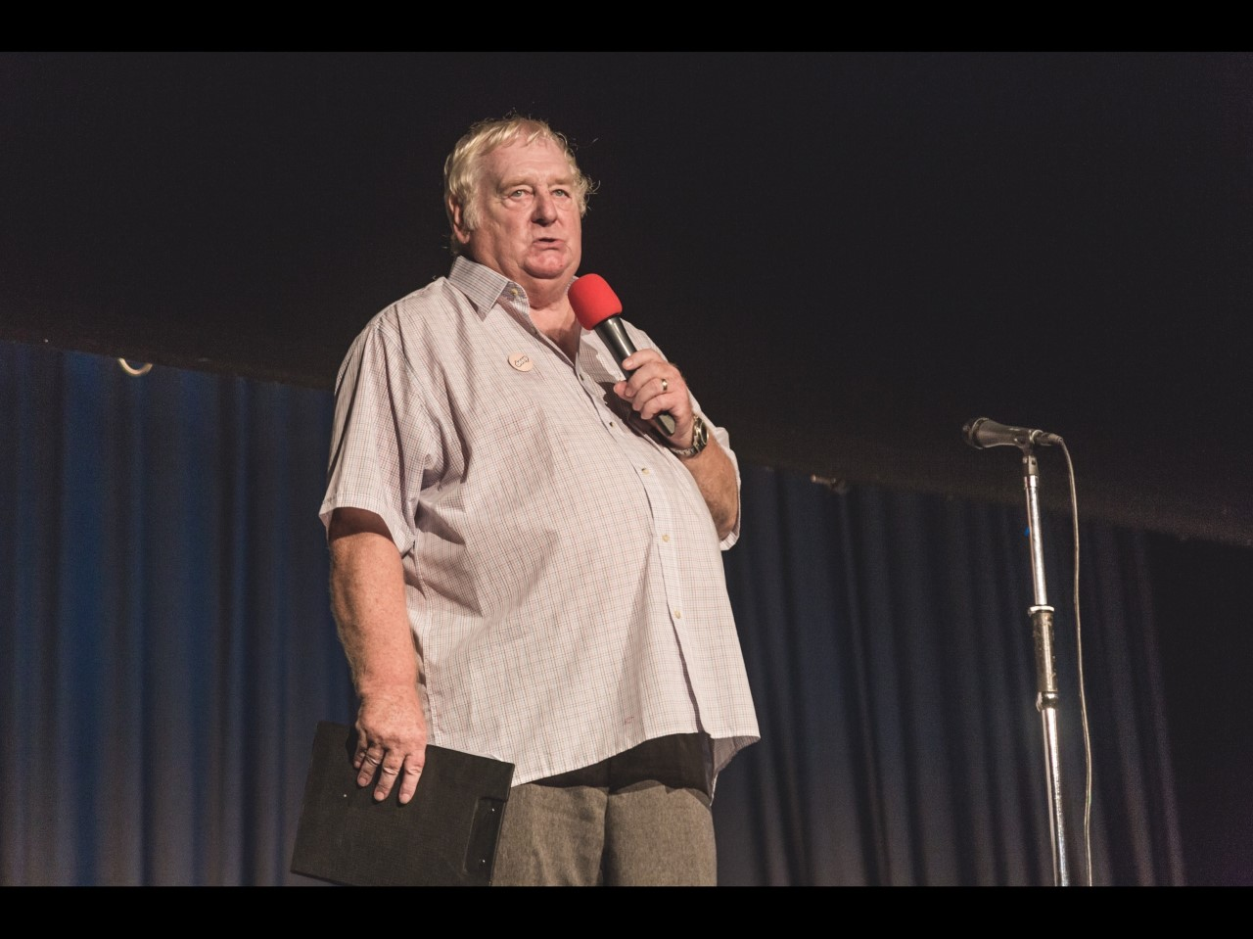

Educate with Steve Clifford

Slide 8
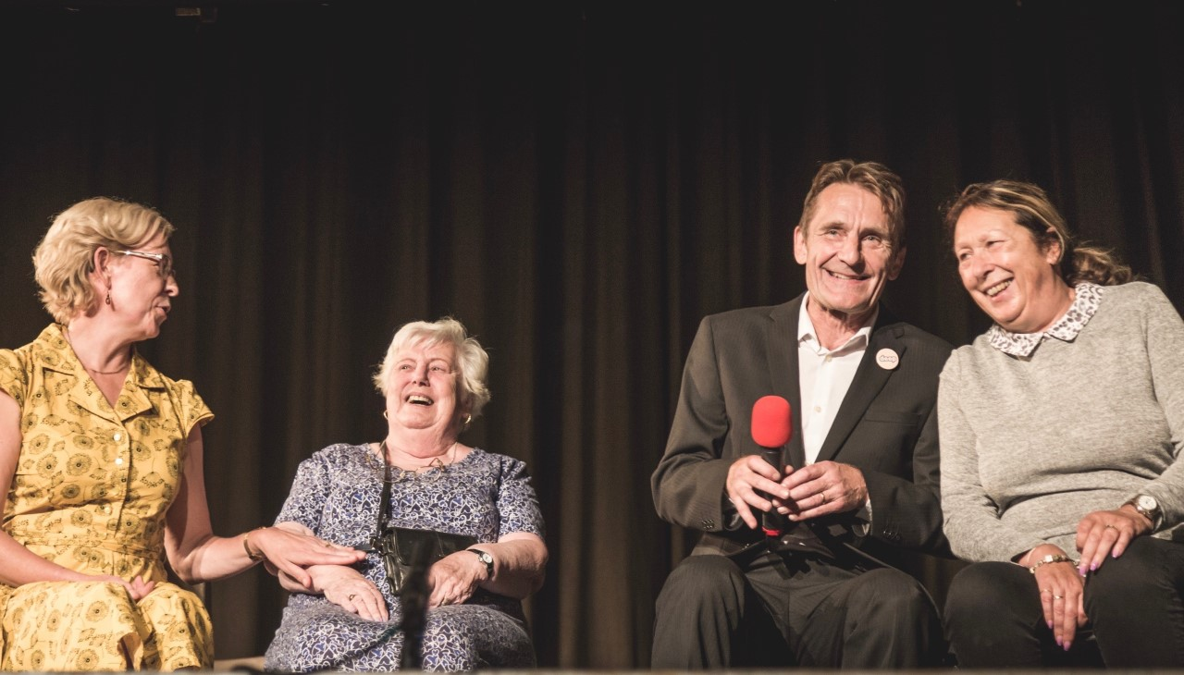
Educate with Steve Clifford

Slide 9
A DEEP pause …

Slide 10
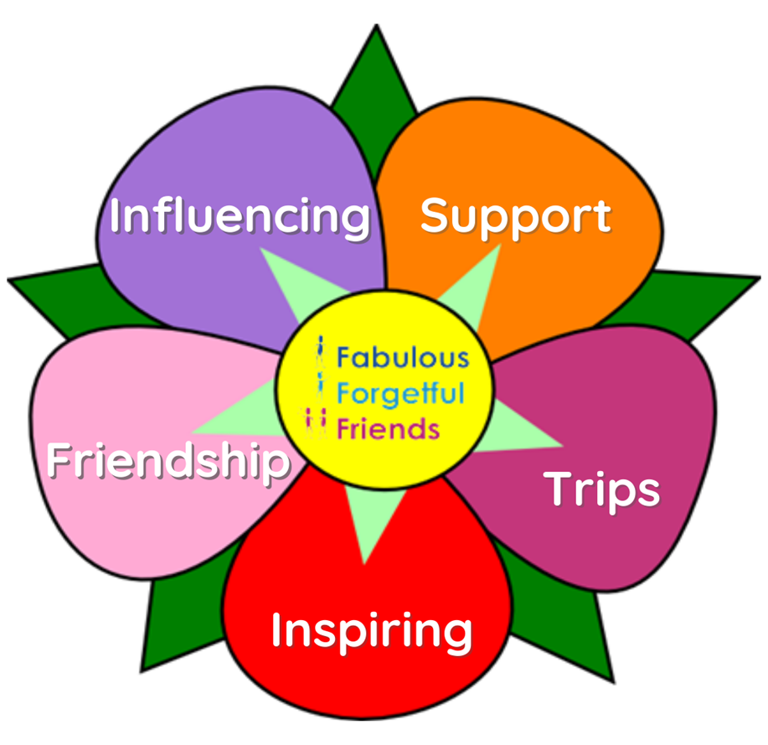
We are the ...Fabulous Forgetful Friends
Our flower has 5 petals
Each one represents
What we stand for.
We created our new logo at our
first face to face meeting coming out
of lockdown in 2022 after we had
decided what we wanted our group
To offer.
But first a trip back to some of
our achievements & adventures

Slide 11


Slide 12
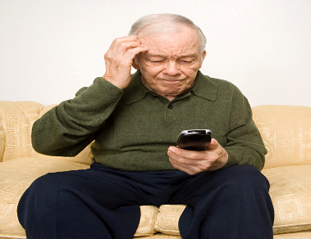

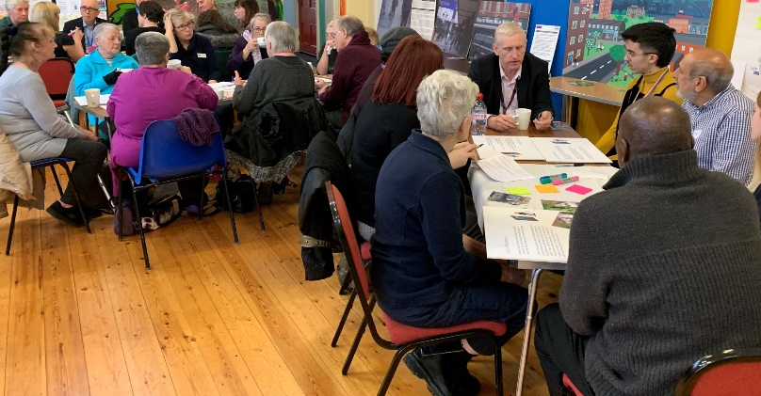
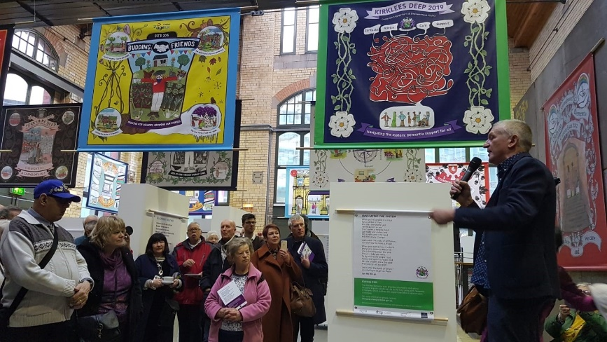
Consumer Research – what is Dementia Friendly ? & how do we ensure our neighbourhoods are Dementia aware.

Slide 13
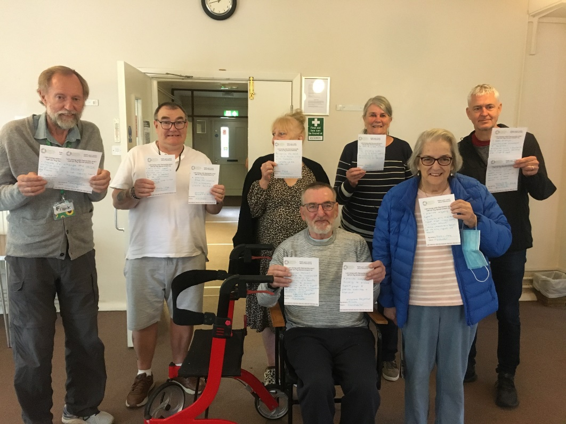
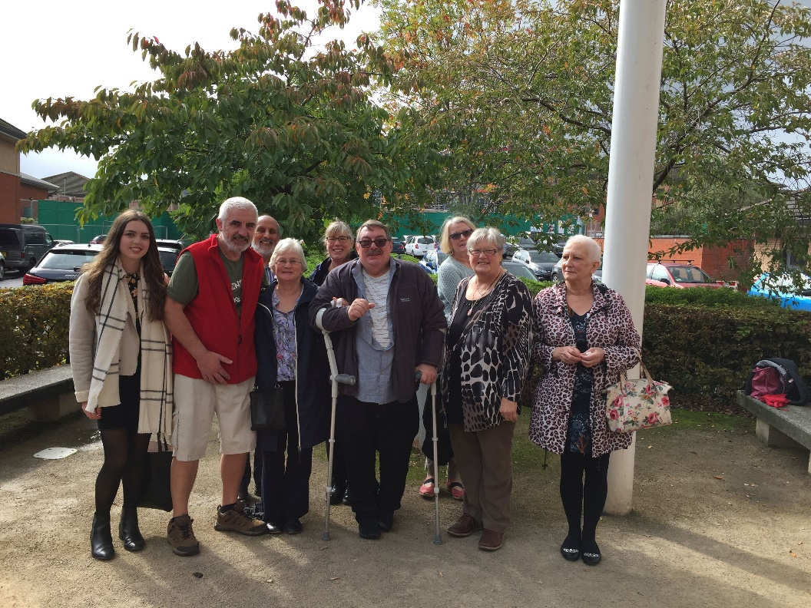
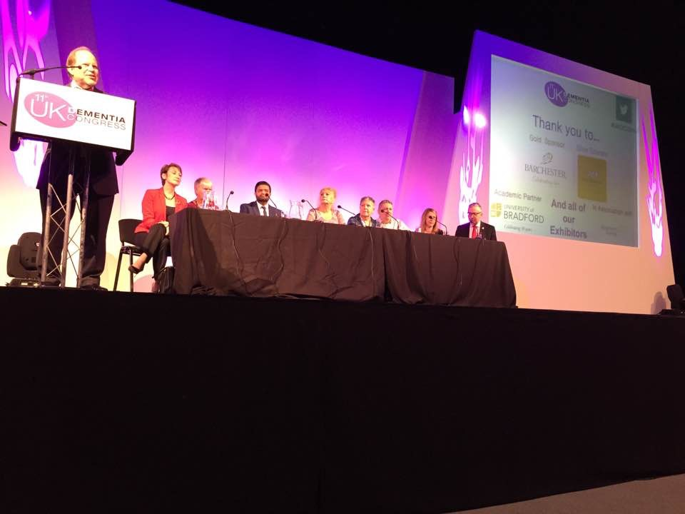
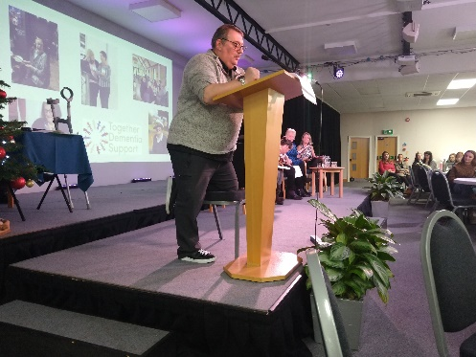
Calling on the government to change …..
Giving talks at hospitals to future nurses & professionals
Speaking at UK Dementia Congress, & other Dementia events

Slide 14
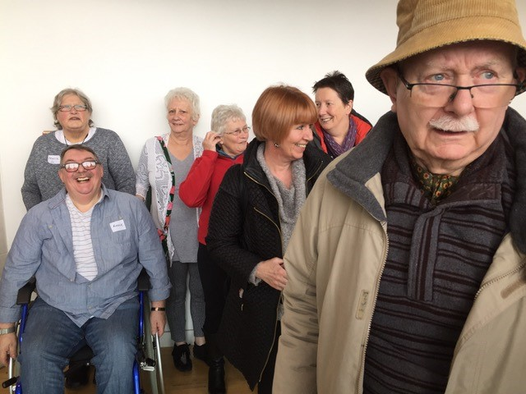
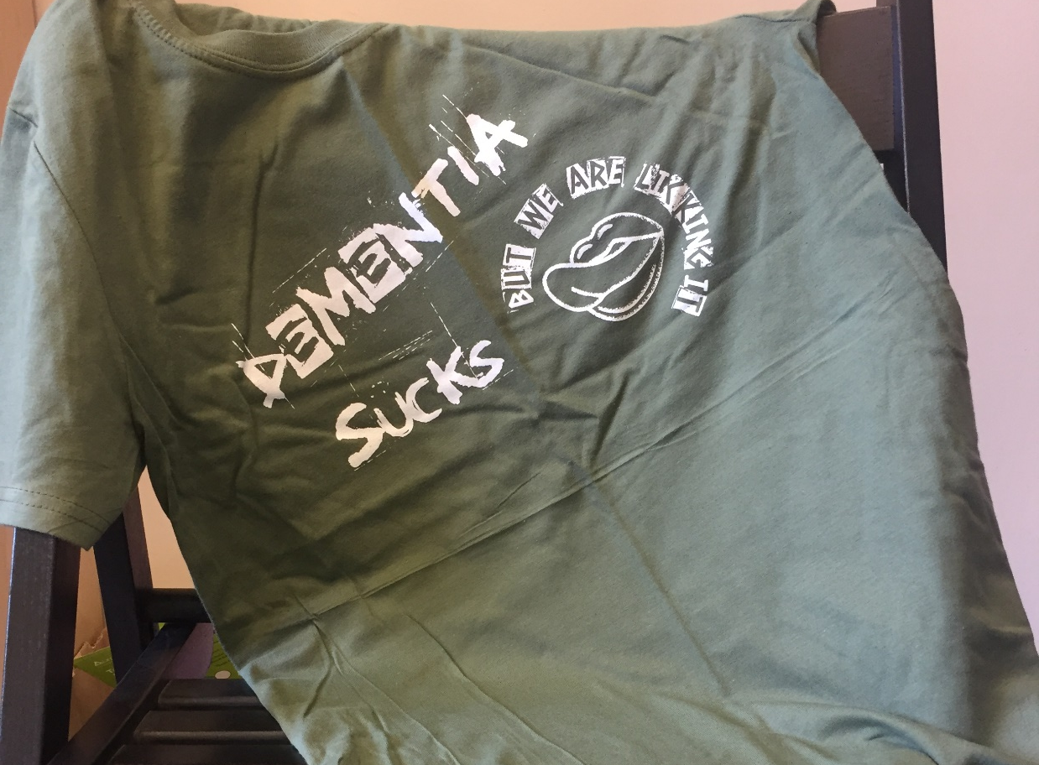
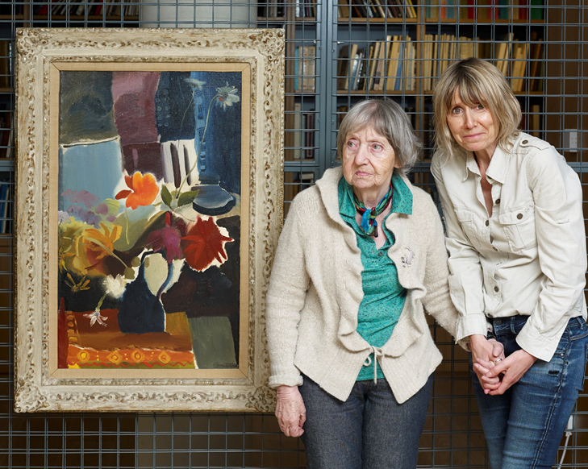
Using Arts & Creative projects eg Whitworth to raise awareness & understanding of what its like to live with Dementia
& demonstrating learning new skills

Slide 15
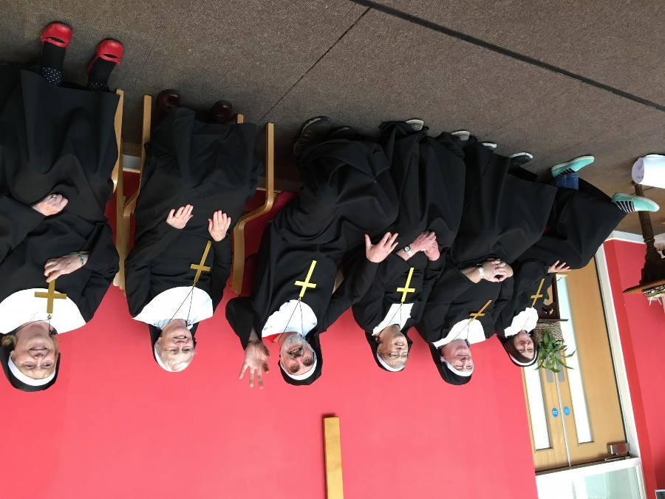

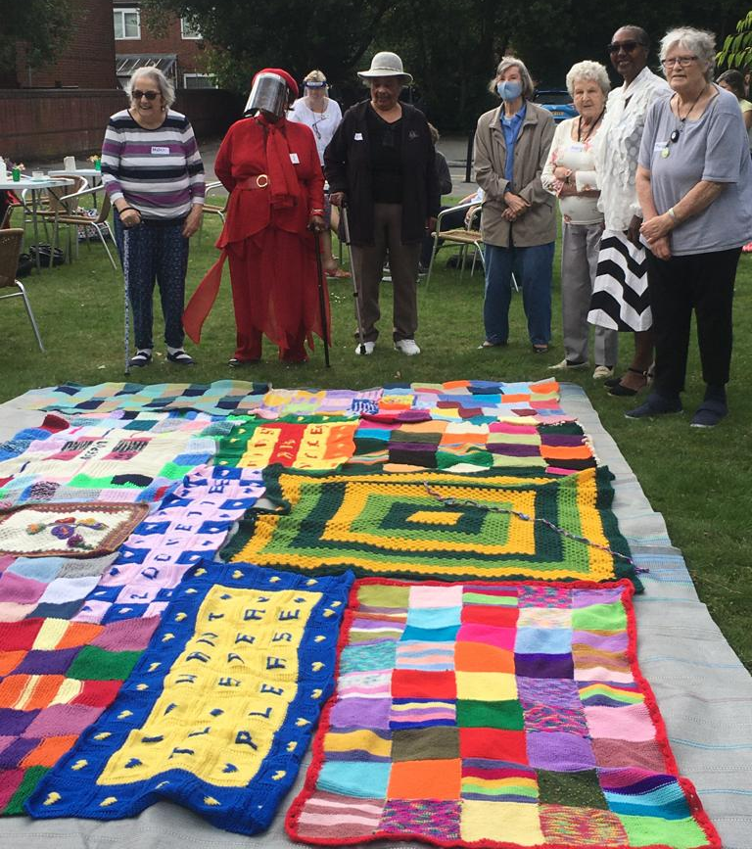
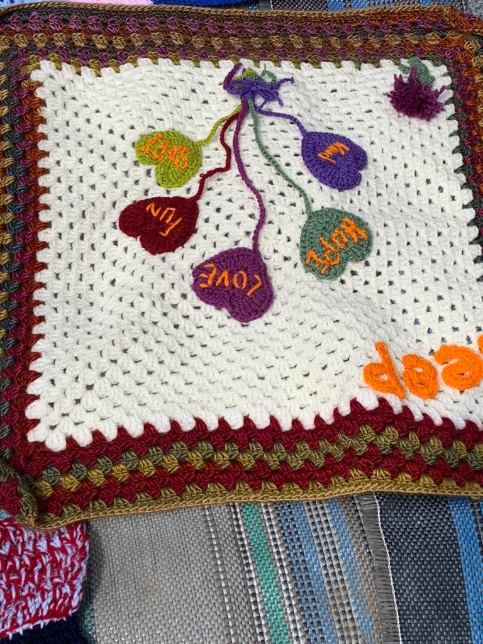
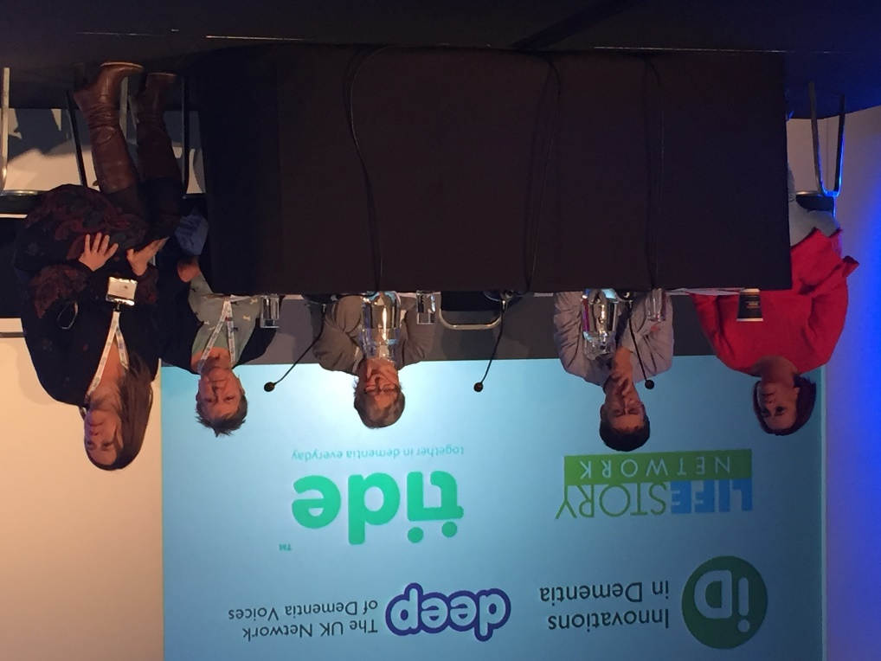
Giving our spin on things having a laugh …unforgettable sound of music
Doing creative projects with our partners DEEP & being part of a bigger picture …

Slide 16
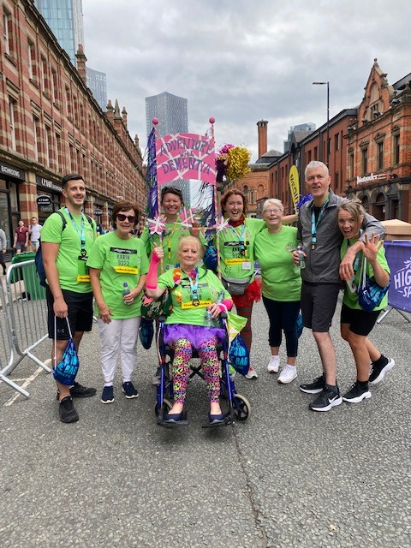
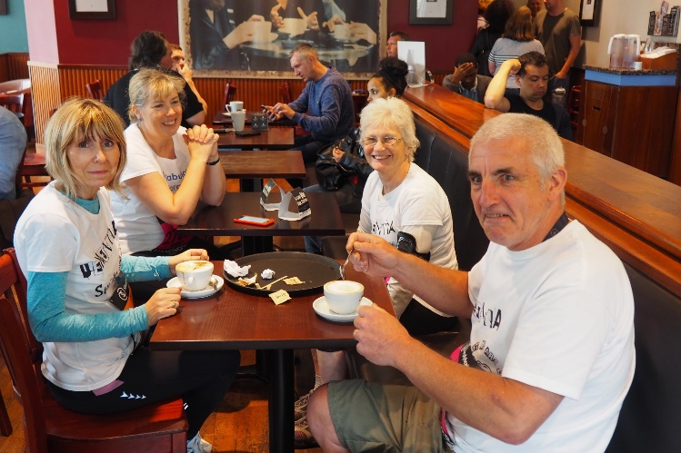
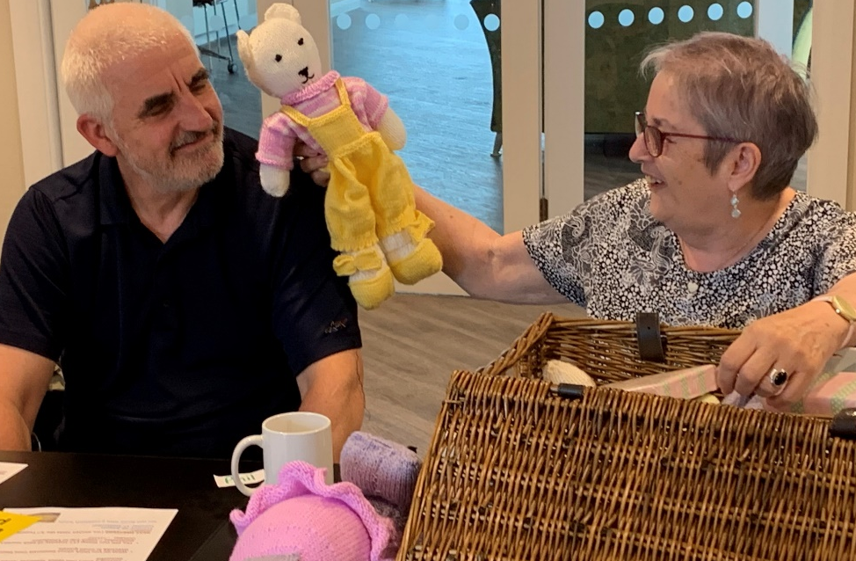
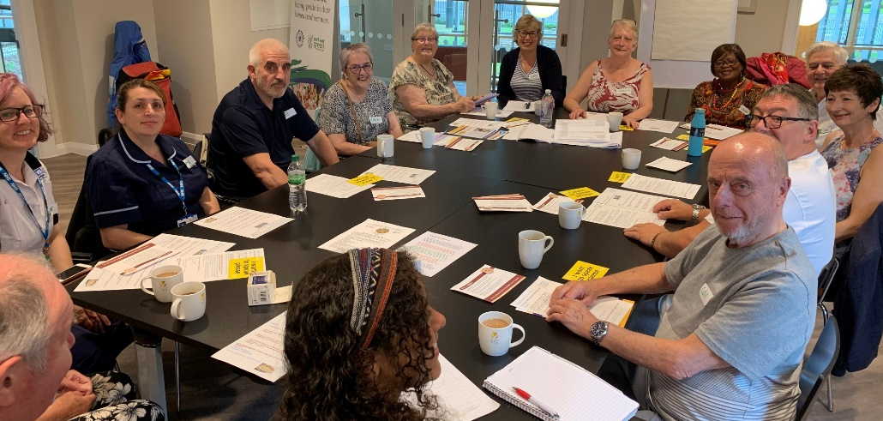
WE make friends and have fun –running in the 10K to fundraise

Slide 17
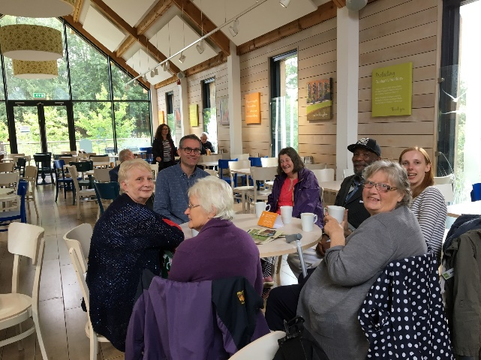
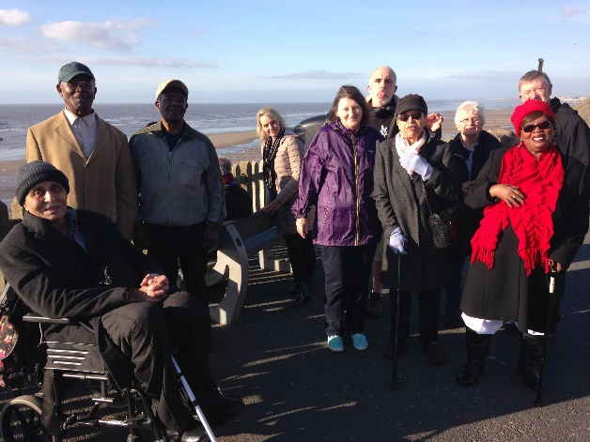
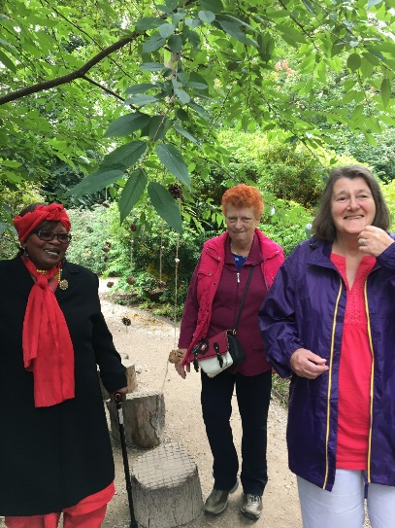
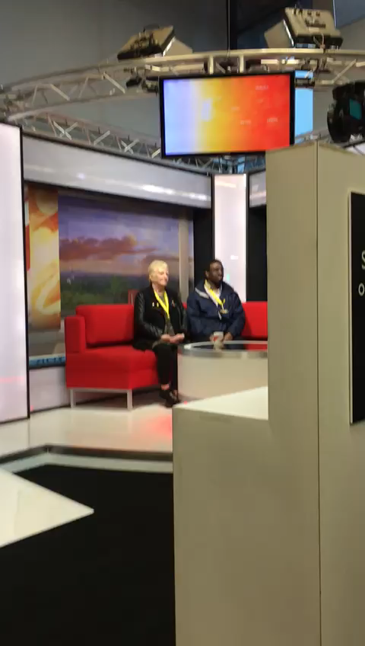
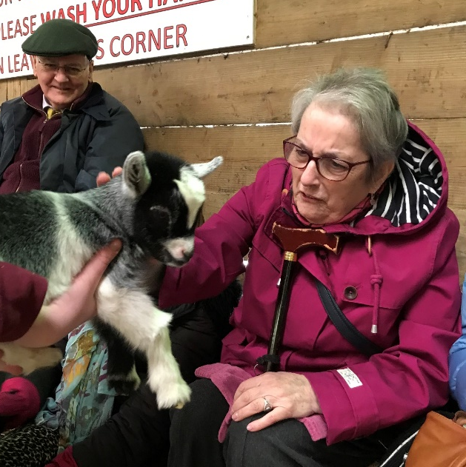
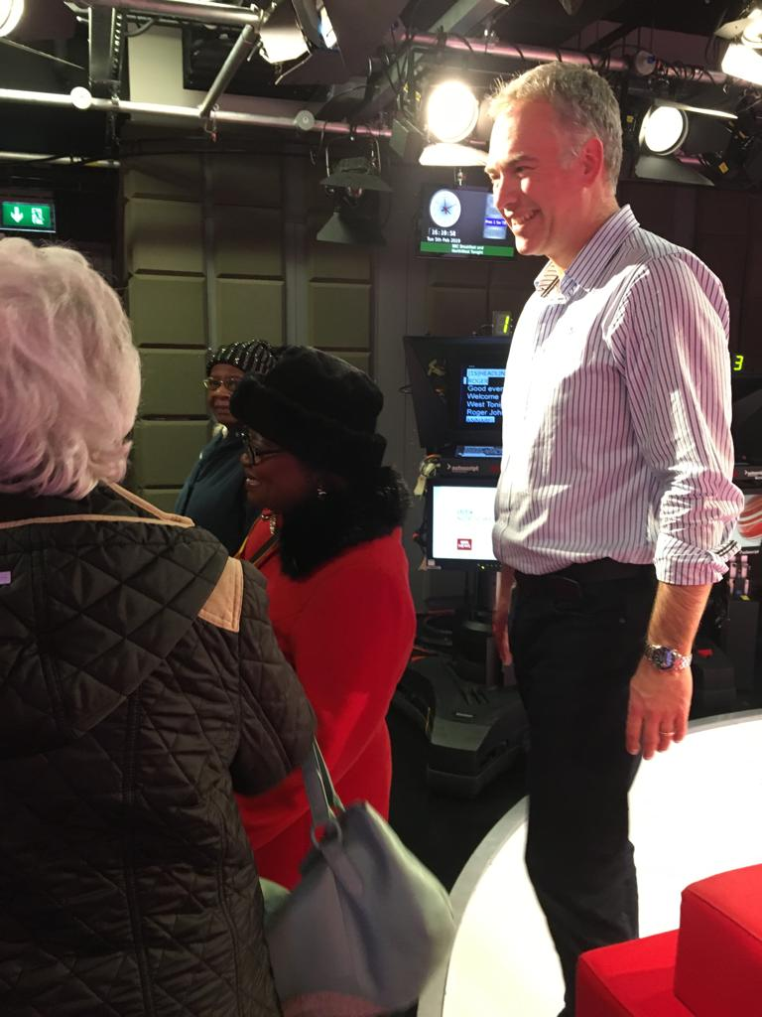
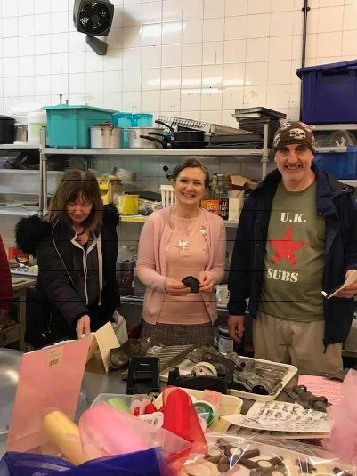
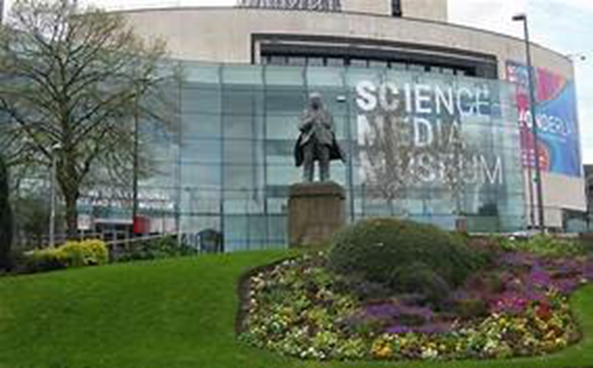
The places
we go , from beaches,
to museums, chocolate factories,
to farms
even reading the news !

Slide 18
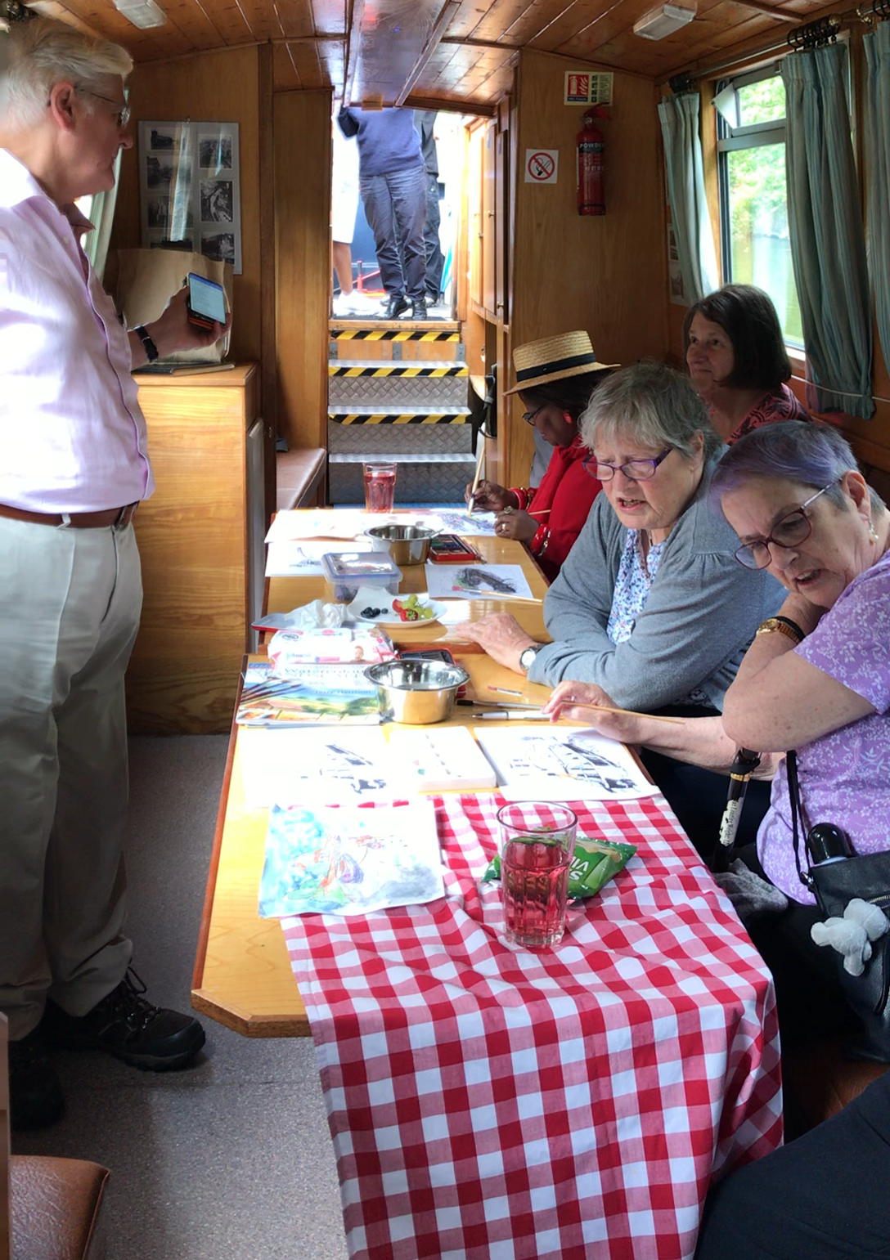
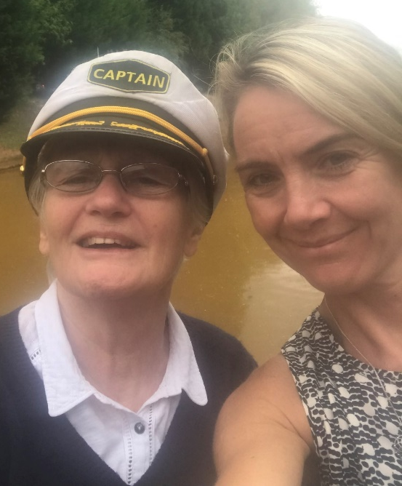
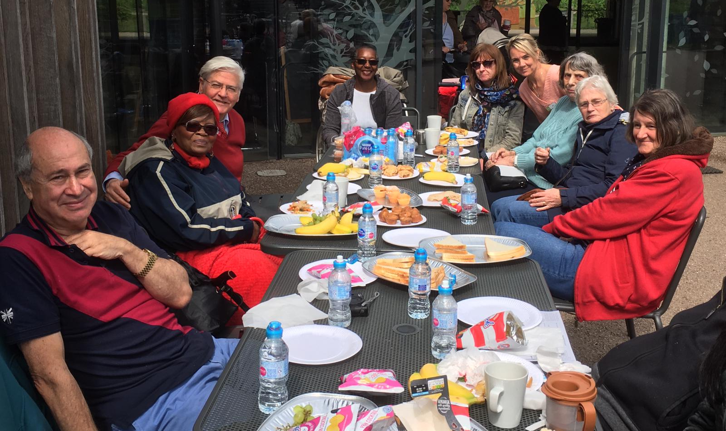
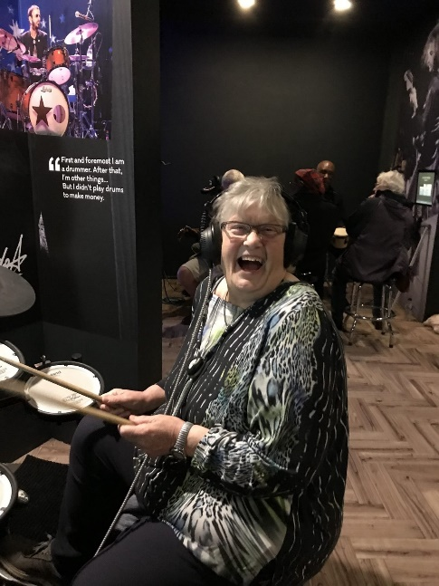
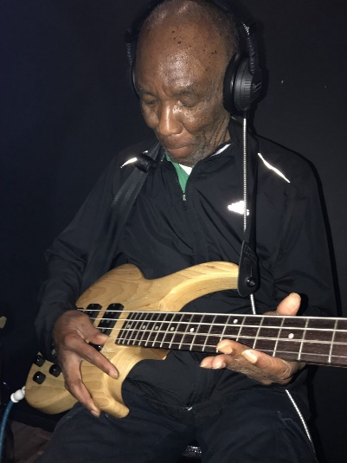
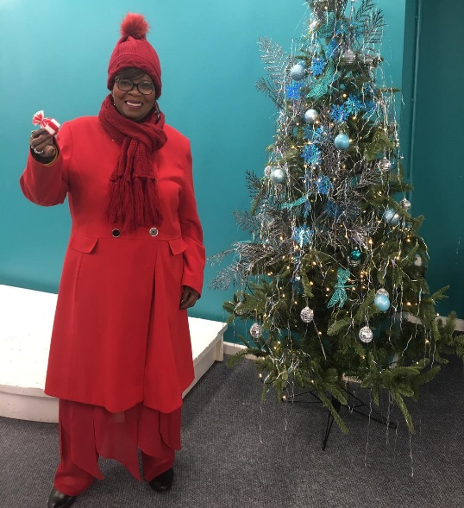
To boat trips, to playing in a band, and a trip on the canal – nothing is beyond our reach

Slide 19
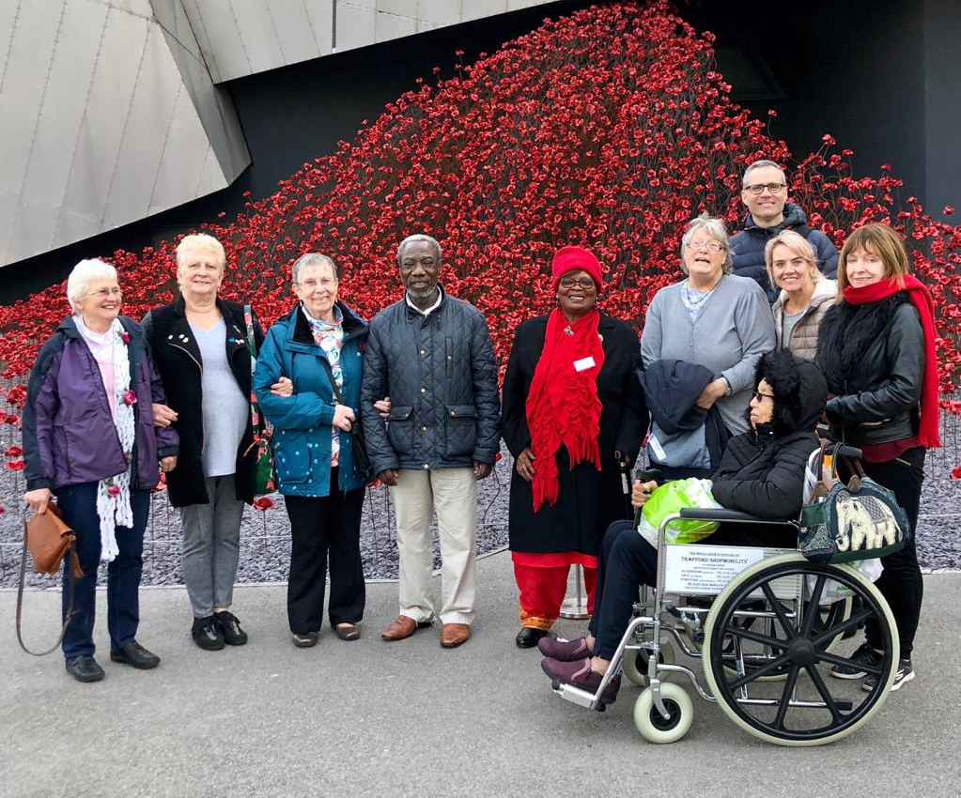
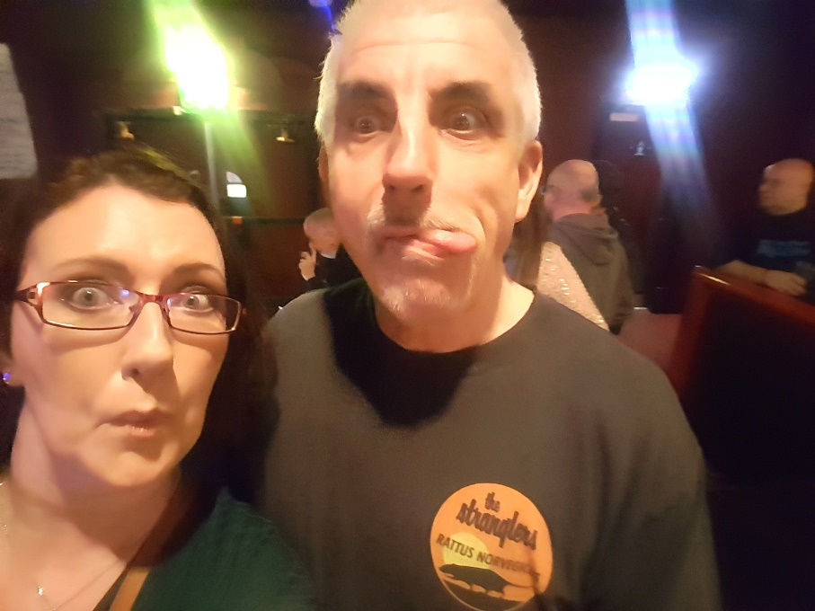
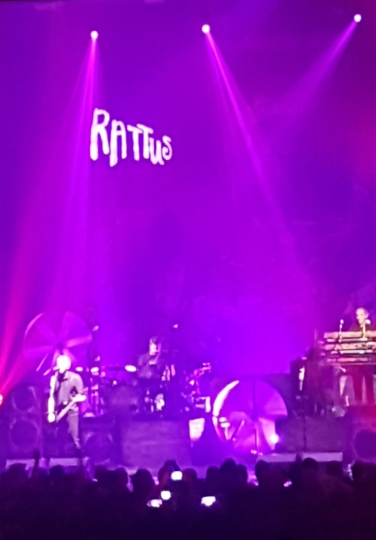
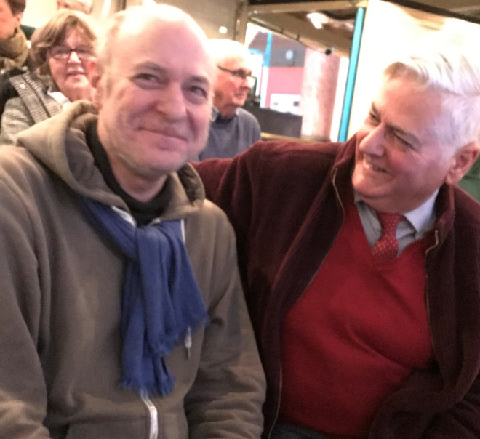
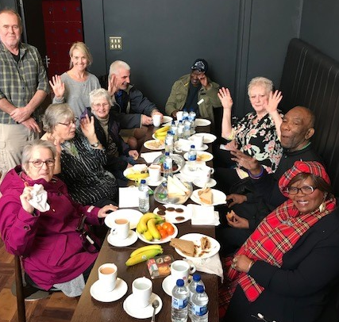
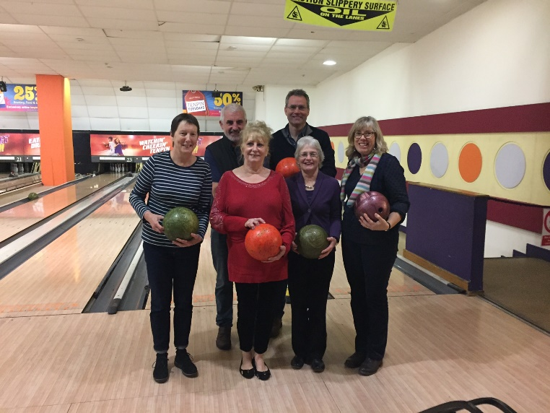
Concerts, theatre, bowling too …

Slide 20
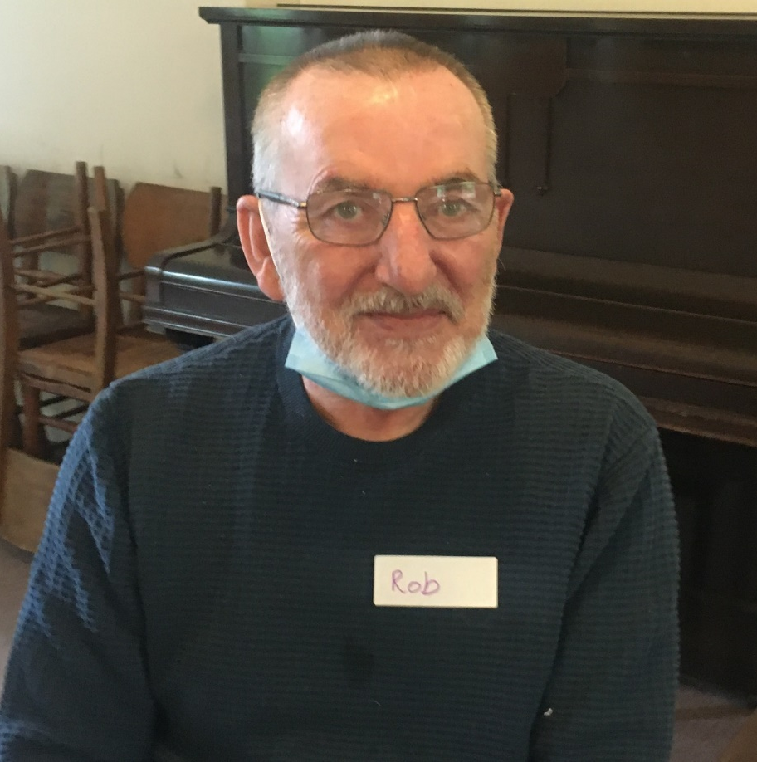
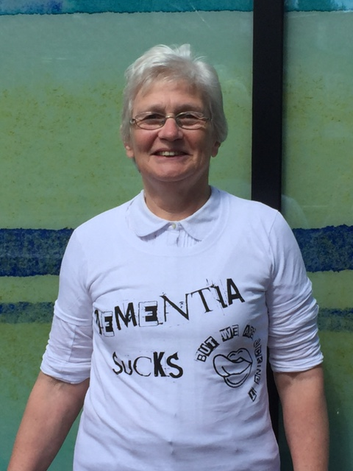
And finally a special moment of reflection to those we have lost always in our thoughts & our hearts.

Slide 21
A DEEP pause …

Slide 22
A DEEP Song
Capturing words and creating a song about what being part of your group and the DEEP Network means to you

Slide 23
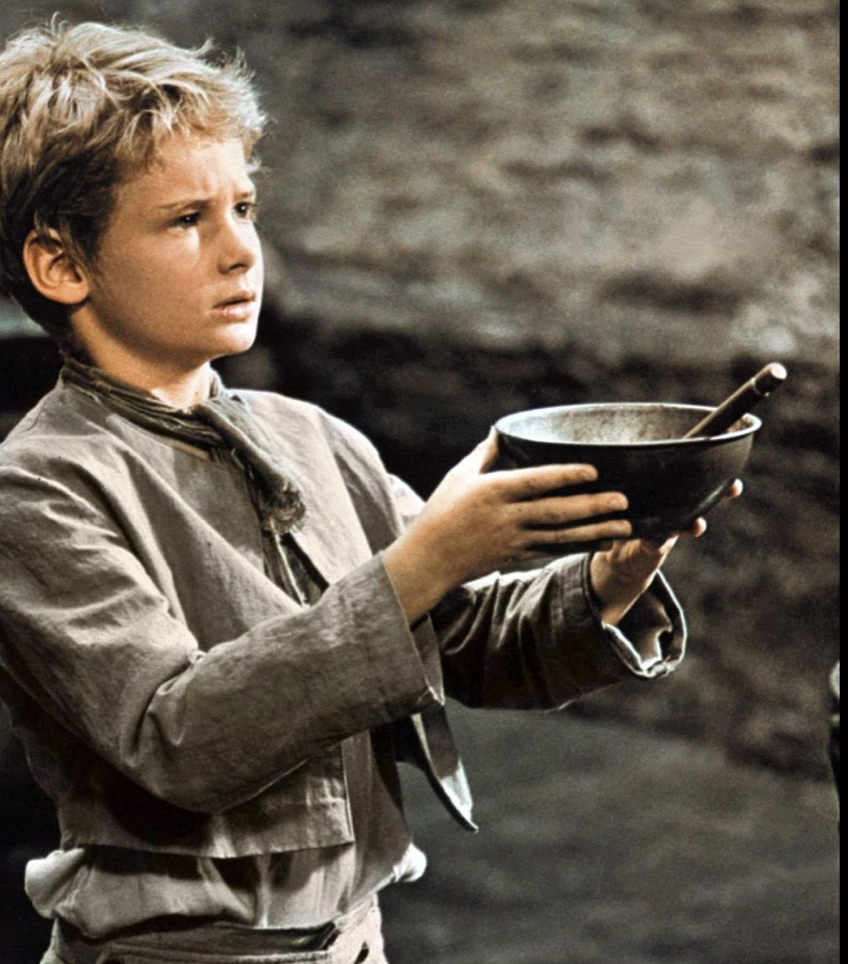
Lunch

Slide 24
Welcome back – a recap of what we have in store this afternoon!
1.30 THRED
1.45 – Forget Me Nots Carlisle
2.00 – Hearing from other groups
2.30 Tea, Coffee and CAKE and THE song work
3.15 THE song performance and thanks
3.30 Homeward bound

Slide 25
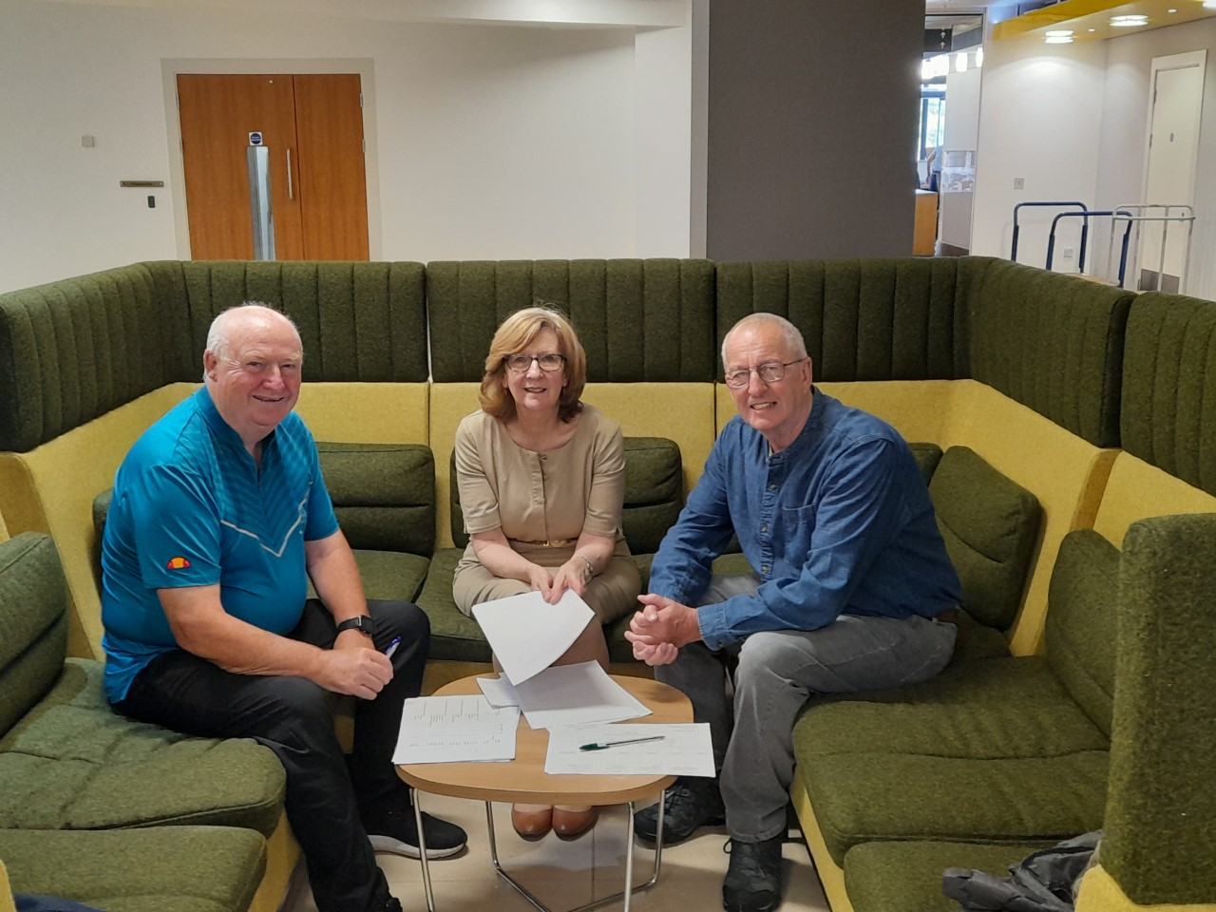
THRED with Tommy, Paul and Pat

Slide 26
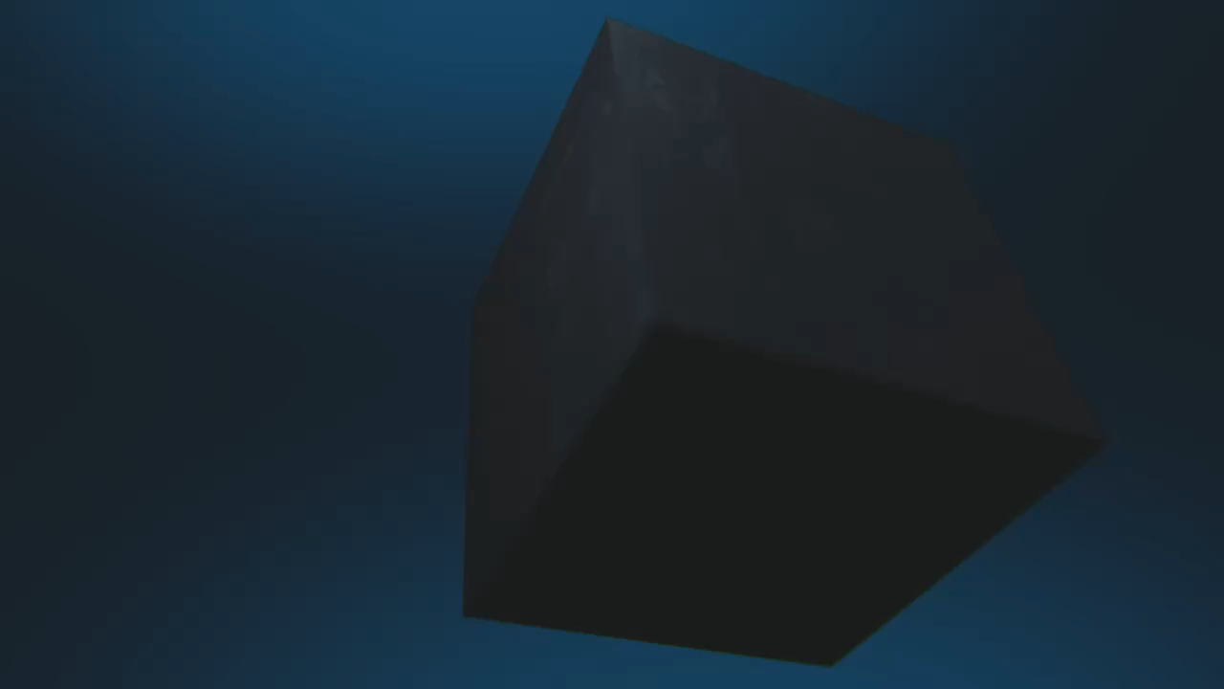
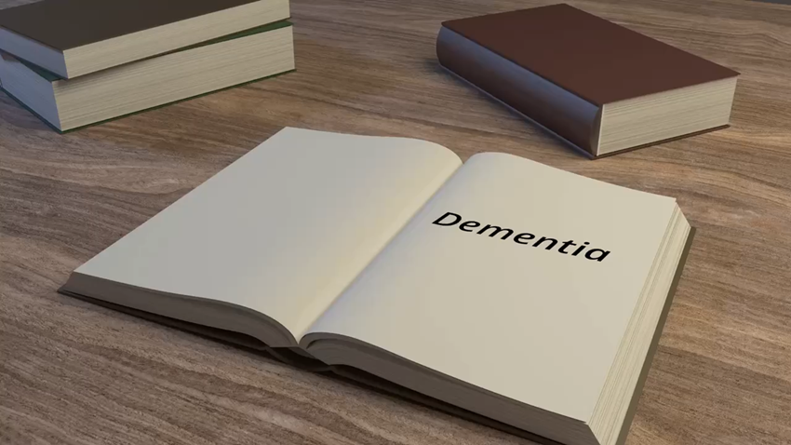
thred CIC

Slide 27
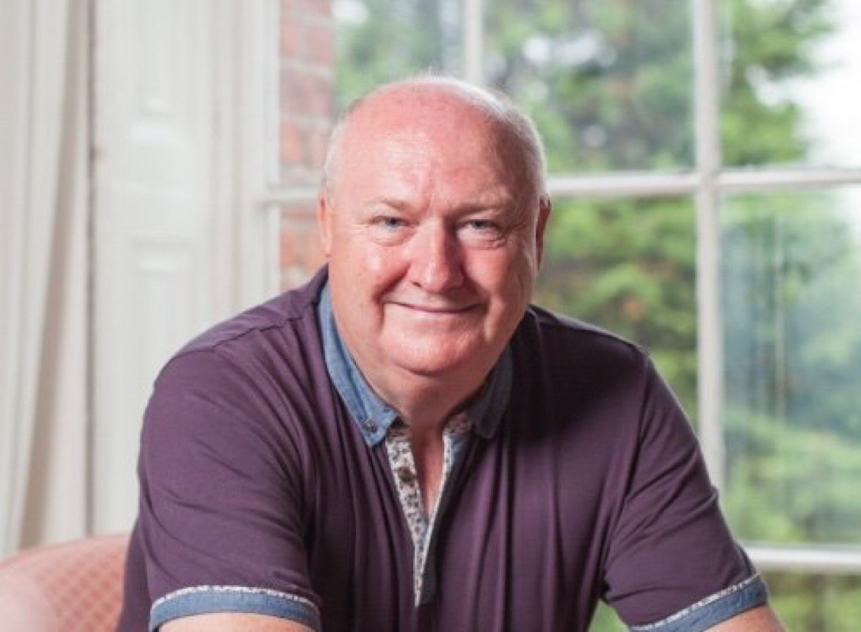
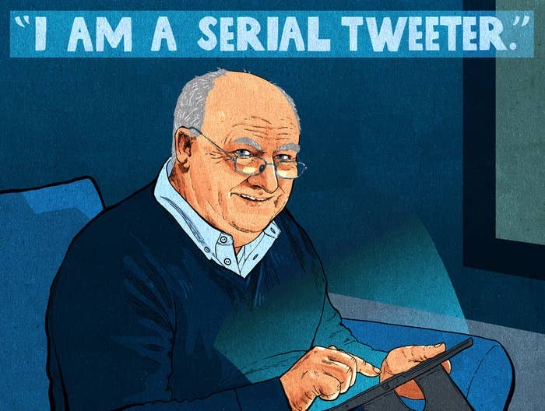
THRED with Tommy

Slide 28


THRED with Paul

Slide 29



THRED with Tommy, Paul and Pat

Slide 30



THRED with Tommy, Paul and Pat

Slide 31



THRED with Tommy, Paul and Pat

Slide 32






THRED with Tommy, Paul and Pat

Slide 33
The toons …..
The Same Man
https://www.youtube.com/watch?v=IUqLxUNnowg
Brave New World
https://www.youtube.com/watch?v=vH9dKe4-_J0

Slide 34



Slide 35
A DEEP pause …

Slide 36

Forget Me Nots Carlisle

Slide 37


The Forget Me Nots

Slide 38
A DEEP Song – by you, Dunne & Hitchmough
It started long ago, maybe 10 years or more
Something seemed to happen
DEEP opened up the doors
All people come together
And started socialising
There was nothing else around
Then we started realising

Slide 39
Chorus
DEEP is only love
Always in our hearts
DEEP is only love
Always in our hearts

Slide 40
Down the long and lonely years
We travelled ALL together
We’ve met so many friends
Whatever the weather

Slide 41
Chorus
DEEP is only love
Always in our hearts
DEEP is only love
Always in our hearts
Through the long and lonely years
We travelled all together

Slide 42
What ever life will hold
Through our laughter and out tears
We can hold our heads up high
To comfort all our fears

Slide 43
The joy of love is happy
The joy of love is true
We feel it every where we go
DEEP is just a call away
For everyone and me and you

Slide 44
Chorus
DEEP is only love
Always in our hearts
DEEP is only love
Always in our hearts
Through the long and lonely years
We travelled all together

Slide 45
A DEEP pause …

Slide 46
More thoughts from you all…

Slide 47


Tea and CAKE …. And finishing touches to the song!

Slide 48
Thanks you and closing thoughts

